Slide 1

Stacks I
Rem Collier
Room A1.02
School of Computer Science and Informatics
University College Dublin, Ireland

Slide 2
Focus Shift…
Data Type: a mechanism for classifying the type of data that a variable (or parameter) may hold.
  E.g. int, double, boolean, …
Data Structure: A composite data type that consists of fields and which represents data in a program (in OOP, this is part of a class).
  E.g. Student, Module, Course, …
Abstract Data Type: a generalized approach to representing and manipulating certain types of data.
  ADT = Data Structure + Algorithms

Slide 3
Abstract Data Types
ADTs are concepts not implementations.
  Normally described as a functional specification.
  Underpinned by multiple implementation strategies.
They identify:
  the characteristics of the data that may be stored within the data structure, and
  the associated operations that may be applied to that data structure (e.g. addition / removal of items)
Key Issues:
  Understanding what potential implementation strategies exist.
  Knowing which strategy to use for a given problem.

Slide 4
Approach (Version 1)
Conceptual Overview
  What the ADT is trying to achieve
Functional Specification
  What operations exist w.r.t. the ADT
Implementation Strategies
  Alternative approaches
  Benefits / Limitations

Slide 5
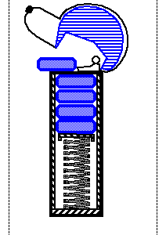
Stacks: Concept
A stack is a container of objects / values.
Insertion and removal based on the last-in-first-out (LIFO) principle.
  Objects can be inserted at any time, but only the last (the most-recently inserted) object can be removed.
Terminology:
  Items are “Pushed” onto the stack (insertion).
  Items can be “Popped” off the stack (removal).
  The “Top” of the stack is the last item pushed
A PEZ® dispenser as an analogy…

Slide 6
Stacks: Functional Specification
Stacks should work with objects.
Core Operations:
  push(o): Inserts object o onto top of stack
  pop(): Removes the top object of stack and returns it
Support Operations:
  size(): Returns the number of objects in stack
  isEmpty():Return a boolean indicating if stack is empty.
  top(): Return the top object of the stack, without
  removing it

Slide 7
Stacks: Impl. Strategies
Array-based Implementation:
  Array holds the objects pushed onto the stack
    Insertion begins at index 0.
    Auxiliary value needed to keep track of the “top” of the stack.
  Finite Capacity
Link-based Implementation:
  Objects stored in special “nodes”
  Nodes maintain ordering information
    Link to the next object in the stack.
  Infinite Capacity

Slide 8

Array-Based Stack
Create a stack using an array by specifying a maximum size N for our stack, e.g., N = 1000.
The stack consists of:
  an N-element array S and
  an integer variable t, the index of the top element in array S.
Illustration:

Slide 9
Array-Based Stack
Algorithm push(o):
Input: an object o
Output: none
t ← t + 1
S[t] ← o
Algorithm size():
Input: none
Output: count of objects on the stack
return t +1
Algorithm isEmpty():
Input: none
Output: true if the stack is empty, false otherwise
return t < 0
Algorithm pop():
Input: none
Output: the top object
e ← S[t]
S[t] ← null
t ← t-1
return e
Algorithm top():
Input: none
Output: the top object
return S[t]

Slide 10
Array-Based Stacks: Dry Runs
View operations as atomic
  Show the state of the array, S, and top element index, t, after each operation
Example:
operation | t | 0 | 1 | 2 | 3 | 4 | 5 | 6 | 7 | 8 | 9
Initial State | -1
Push(H) | 0 | H
Push(A) | 1 | H | A
Push(A) | 2 | H | A | A
Pop() | 1 | H | A
Push(P) | 2 | H | A | P
Push(P) | 3 | H | A | P | P
Push(Y) | 4 | H | A | P | P | Y

Slide 11
Array-Based Stacks: Impl.
Class name: ArrayStack
  Fields:
    An array of objects, S
    An integer, N (array size)
    An integer, t (top index)
  Constructors
    Default Constructor (sets N to 1000)
    Constructor with 1 integer parameter (used to set value of N)
  Methods:
    1 per operation: methods names should match operation names – except for naming conventions (lower case first letter)
    Implement methods based on pseudo code
This is part of your next worksheet

Slide 12
Array-Based Stacks: Analysis
Operation Running Times:
Issues:
  What happens if we pop from an empty stack?
  What happens if we push onto a full stack?
Operation | Running Time
Push(o) | O(1)
Pop() | O(1)
Top() | O(1)
IsEmpty() | O(1)
Size() | O(1)

Slide 13
Applications
Reversing Arrays
Parenthesis Matching
Managing Program Execution

Slide 14

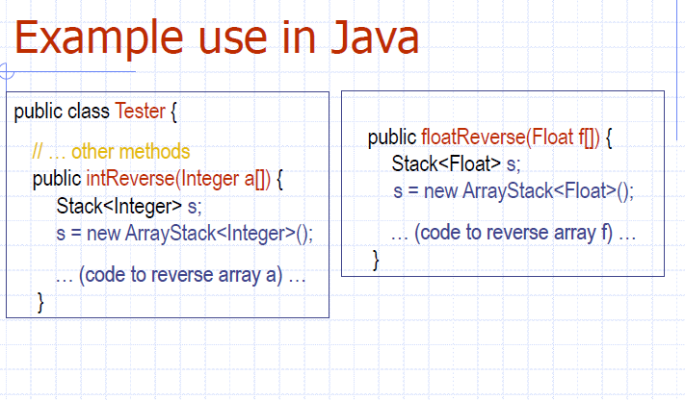

Slide 15
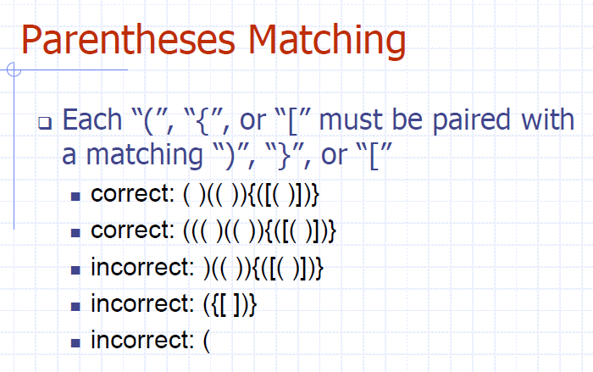

Slide 16
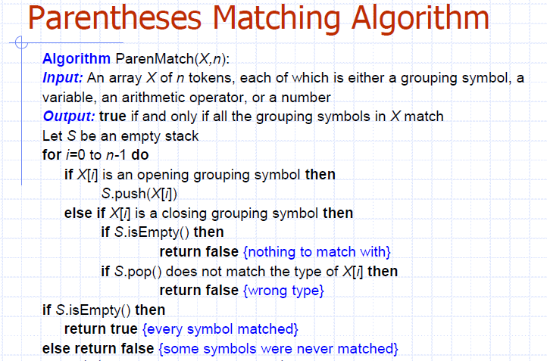

Slide 17
